Slide 1
Gale Courses

Slide 2
GALE COURSES: ONLINE LEARNING OPPORTUNITIES
General Business Skills,
Sales and Marketing,
Management and Leadership
Accounting Skills
Grant Writing
Business Communication & Writing
Business Writing
Starting your own Business
College Readiness
Teaching & Education
Classroom Computing
Healthcare and Medical (Ancillary, Veterinary, Alternative)
Health Care Certificates
Ethics, Law, & Compliance
Business
Skills
Healthcare &
Education
Coding
Programming
Software Applications
Web Design
Data Science
Networking and Communication
Database Management
Photography
Gardening
Parenting
Writing
Personal Finance
Language Learning
Technology
Personal
Enrichment
Notes:
Full courses have been developed to support multiple key adult education categories including technological skills, business skills, and personal development. Patrons have the option to browse different categories using the Explore button next to the tool bar.

Slide 3
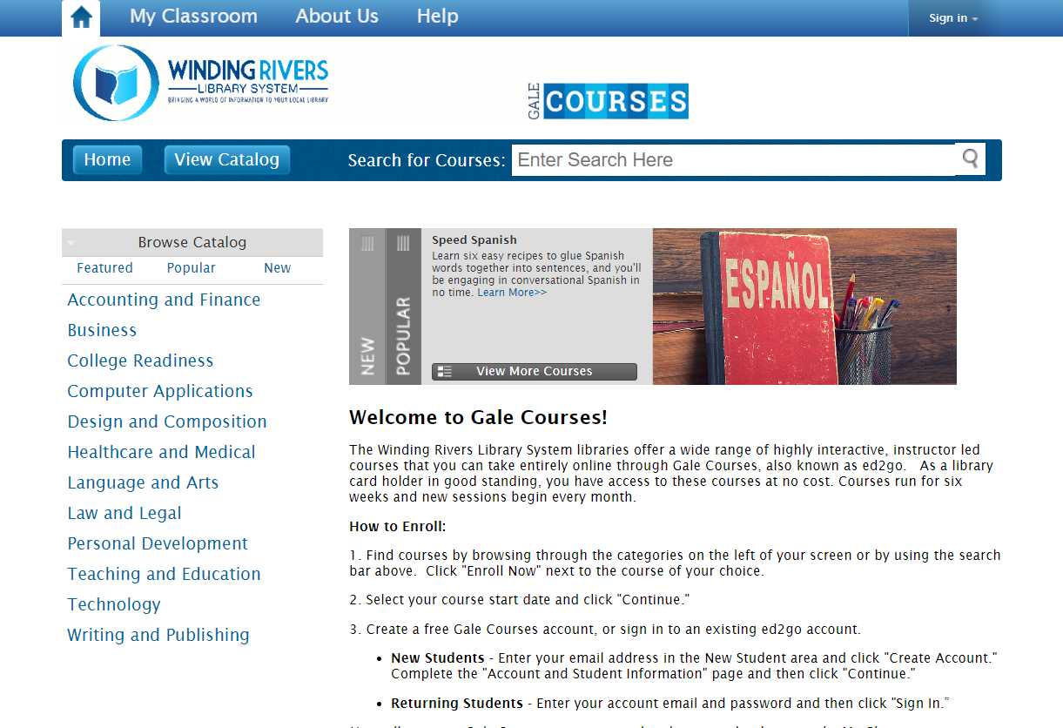
GALE COURSES
Instructor-Led Courses
All courses are taught by college instructors who are experts in their field.
Interactive Learning
All courses are enhanced with images, videos, and games to support varied learning styles. Engage with fellow students and instructor through weekly discussion boards.
Sessions Start Monthly
New courses begin each month, and lessons are assigned twice a week. Users will enjoy a self-paced learning environment.
Wide Course Offerings
With courses covering professional development, technology, and personal enrichment topics, there is something for everyone.
Six Week Courses
All courses follow a convenient, 6-week format that can be accessed 24/7 on any computer or mobile browser.
Completion Award
Receive a certificate of completion upon finishing the course with a passing score.

Slide 4
ACCESSING THE RESOURCE

Slide 5
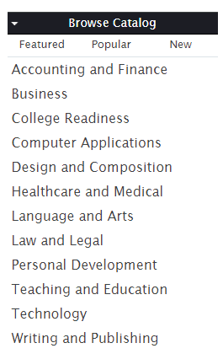
ACCESSING YOUR AVAILABLE GALE COURSES
GET STARTED
Access Gale Courses from your library website.
Browse Catalog to discover the courses available.
When you find a course you want to take, select Enroll Now.

Slide 6
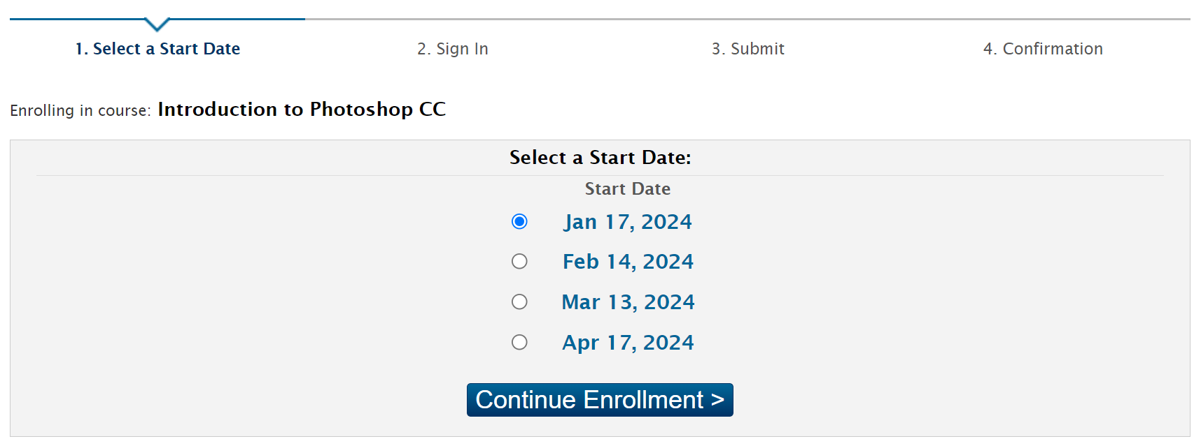
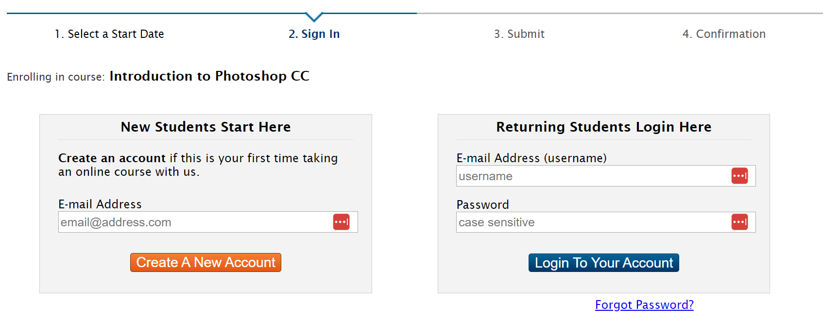
ACCESSING YOUR AVAILABLE GALE COURSES
CHOOSE A START DATE
Select a start date for your course
NEW STUDENTS
You will be prompted to create a free account.
Enter your email address in the New Student area and click Create Account.
Then complete the Account and Student Information page, click continue when finished.
RETURNING STUDENTS
Enter your account email and password, then click Sign In.

Slide 7
ACCESSING YOUR AVAILABLE GALE COURSES
ENROLLMENT CONFIRMATION
You will receive confirmation of enrollment in your selected course.
Enrollment information will include the Course Name and Start Date.
Select Enter My Classroom to access and begin your course.
IMPORTANT TO NOTE:
Students who have enrolled in a course must log in and view lessons one and two within 13 days after the start date of the course, or they will be automatically dropped. Students who are dropped from a course will be able to enroll in the course during a later session.

Slide 8
NAVIGATION AND DISCOVERY
Notes:
This section walks through how to utilize the platform to find content.

Slide 9
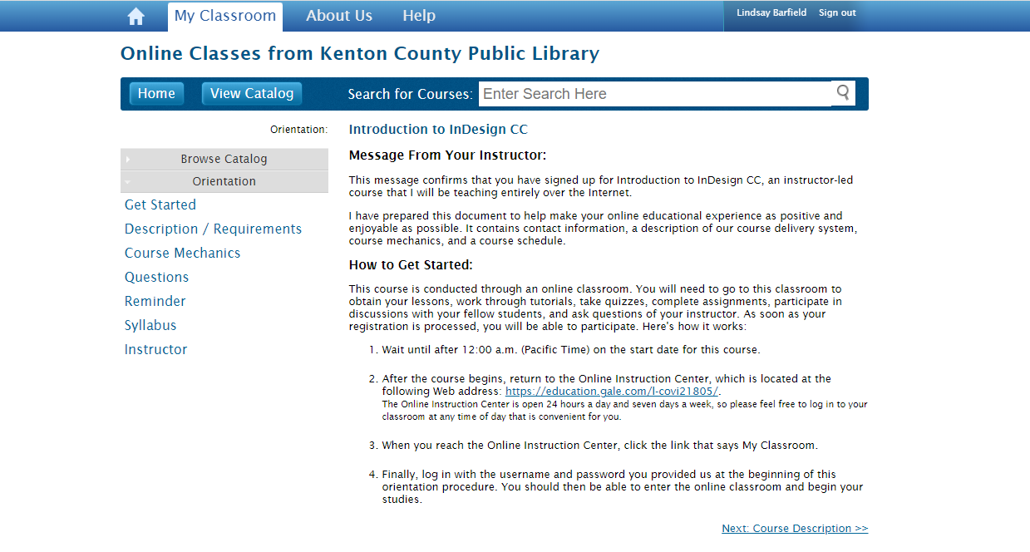
COURSE ORIENTATION
Once you enter My Classroom, visit the sidebar to access:
Course Description
Course Mechanics
Questions
Reminders
Syllabus
Instructor Information

Slide 10
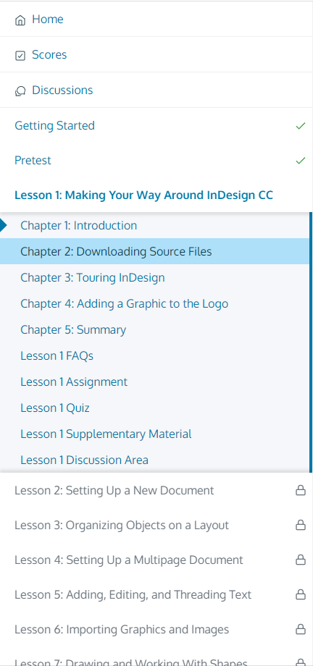
COURSE NAVIGATION
Once you enter your course, the navigation pane on the left side of your screen is where you will access all course content, including:
Instructional Videos
Learning games
Assignments
Quizzes
Supplementary Materials
Discussion Boards
And more!

Slide 11
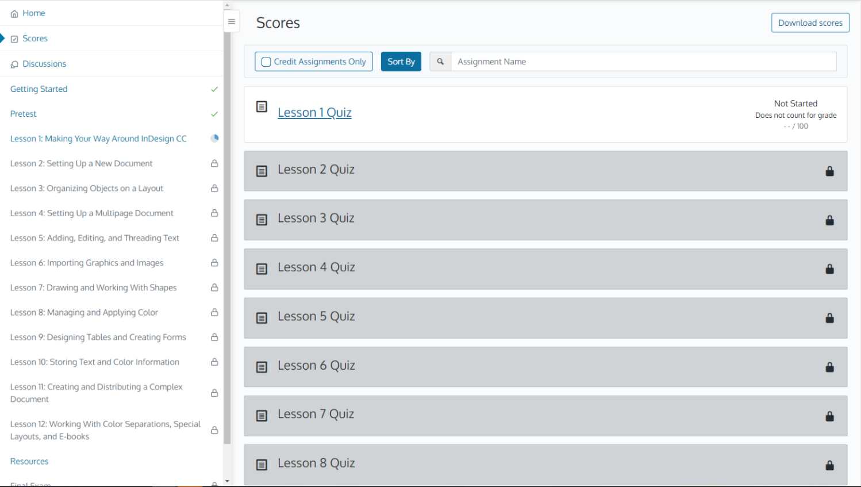
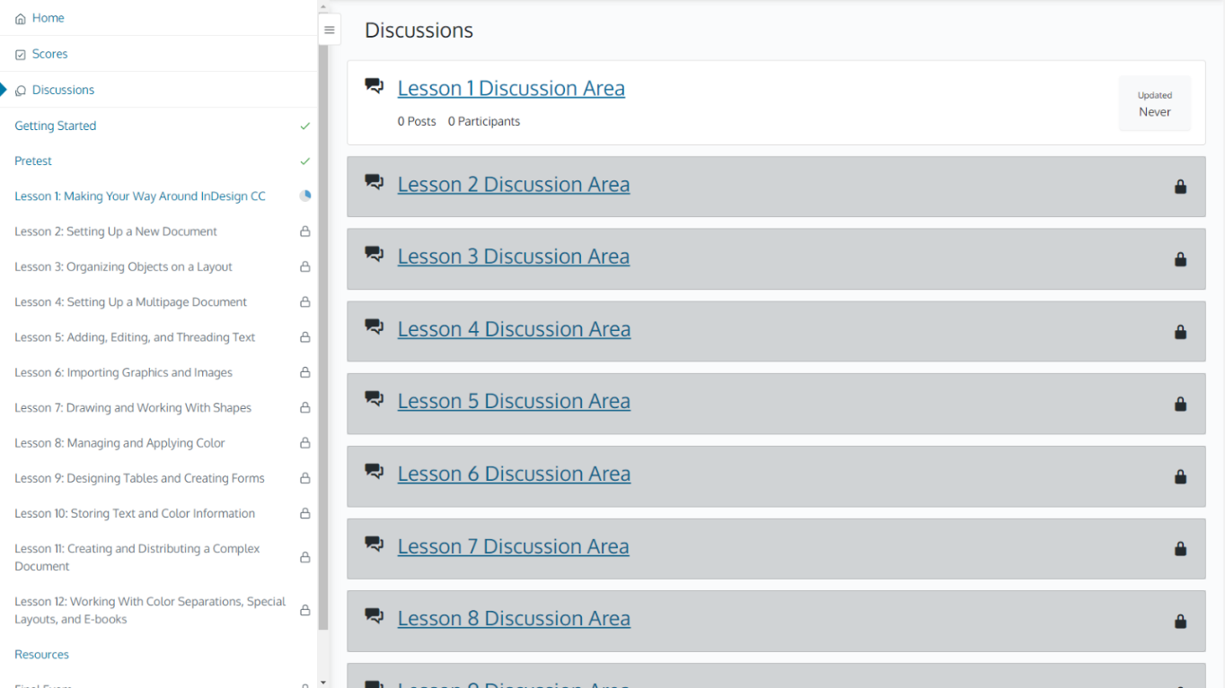
COURSE NAVIGATION
View all your Scores and Discussions in one convenient location

Slide 12
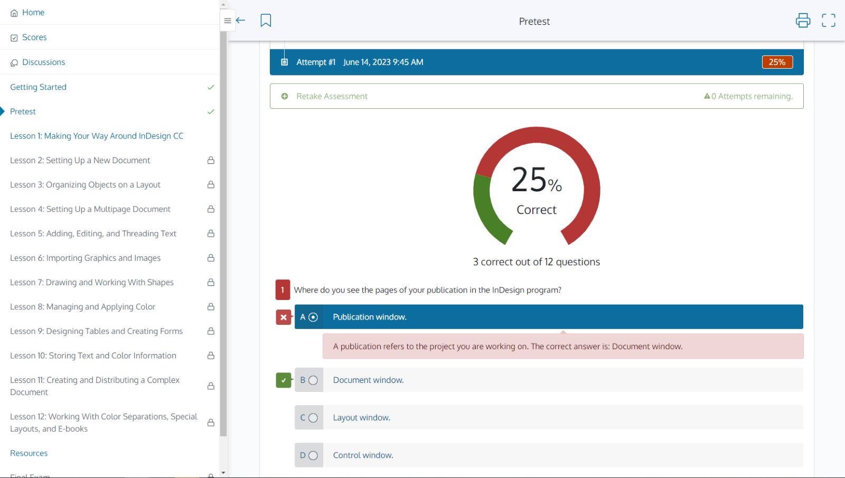
COURSE NAVIGATION
Most courses have a Pretest that allows you to gauge baseline knowledge going into the course.
Compare these results to your test at the end of the course to see how much you have learned!

Slide 13
COURSE NAVIGATION
Follow the learning path to view your course’s progression and complete activities and assignments.
A check mark will appear next to each item once complete.

Slide 14
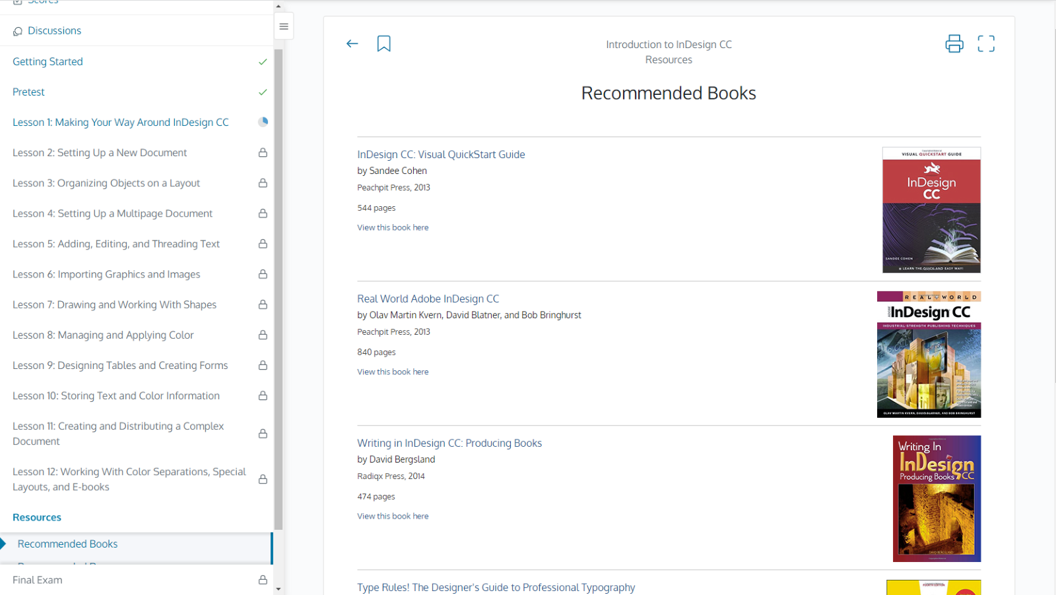
COURSE NAVIGATION
Be sure to check out the Resources tab for additional recommended materials, like recommended books

Slide 15
?
…
Notes:
Use this slide as a visual prompt for final questions and/or discussions. If you have the time, try to access Gale Presents: Udemy and provide a walkthrough before questions.

